Slide 1
Neural Radiance Fields
Aria Puri, Harkirat Gill, Kelly Jiang

Slide 2
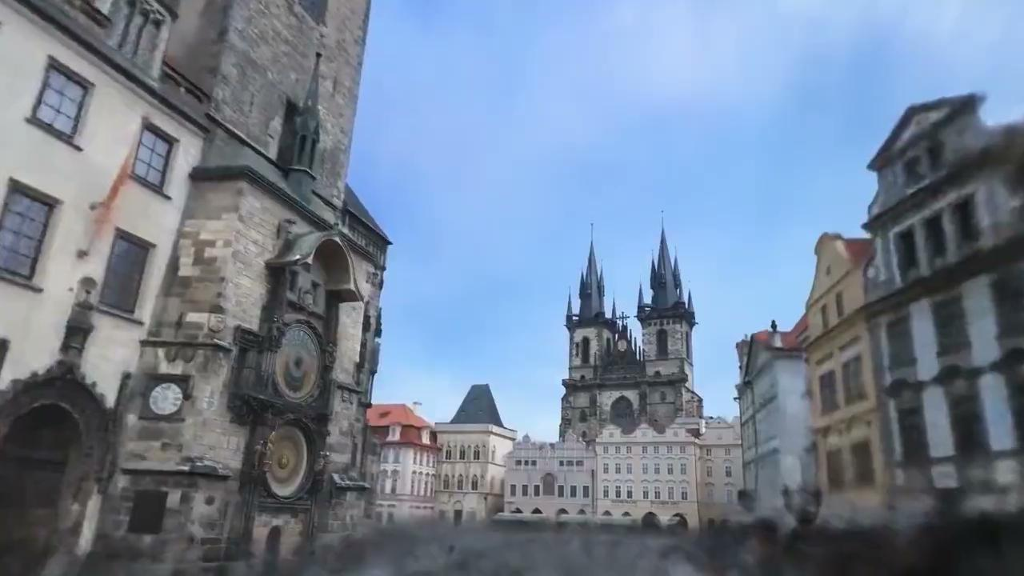
NeRF in the Wild (Martin-Brualla et al 2020)

Slide 3
Neural Rendering Background

Slide 4
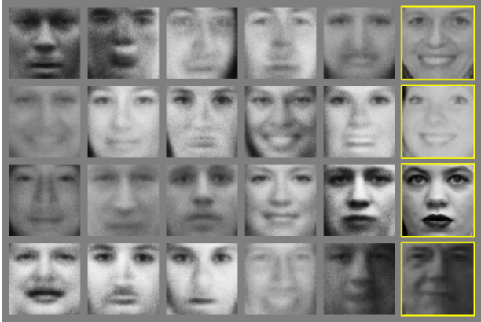
2014
2015
2016
2017
2018
2019
2020
2021
2022

Slide 5
Generative Adversarial Networks (Goodfellow et al 2014)
2014
2015
2016
2017
2018
2019
2020
2021
2022

Slide 6
GANs
Popularized deep learning for image generation
Key innovation: the introduction of a novel loss function

Slide 7
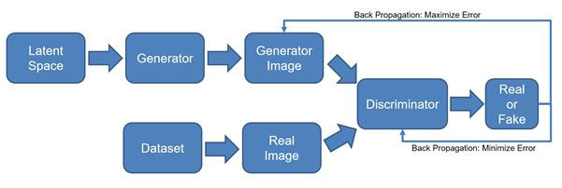
GANs
Popularized deep learning for image generation
Key innovation: the introduction of a novel loss function
Source: https://medium.com/@Packt_Pub/inside-the-generative-adversarial-networks-gan-architecture-2435afbd6b3b

Slide 8
GANs
Popularized deep learning for image generation
Key innovation: the introduction of a novel loss function
Principle: jointly train two networks. The generator network creates images. The discriminator network distinguishes between real and fake images.

Slide 9
Summary of GANs
Pros
Perceptually realistic, sharp output
Images are generated directly from latent codes, so inference is fast

Slide 10

Summary of GANs
Pros
Perceptually realistic, sharp output
Images are generated directly from latent codes, so inference is fast
Source: A Style-Based Generator Architecture for Generative Adversarial Networks (Laine, Karras, Aila 2019)

Slide 11
Summary of GANs
Pros
Perceptually realistic, sharp output
Images are generated directly from latent codes, so inference is fast
Cons
Impossible to precisely control content of generated images
Geometric artifacts: GANs have no conception of 3d shape

Slide 12
Summary of GANs
Pros
Perceptually realistic, sharp output
Images are generated directly from latent codes, so inference is fast
Cons
Impossible to precisely control content of generated images
Geometric artifacts: GANs have no conception of 3d shape
In particular, we would like to achieve novel view synthesis. We should be able to view an existing subject from a new angle

Slide 13
Aside: StyleGAN-3
2014
2015
2016
2017
2018
2019
2020
2021
2022

Slide 14

Aside: StyleGAN-3
Alias-Free Generative Adversarial Networks (Karras et al 2021)
2014
2015
2016
2017
2018
2019
2020
2021
2022

Slide 15
Aside: StyleGAN-3
The current limit of GANs for novel view synthesis

Slide 16
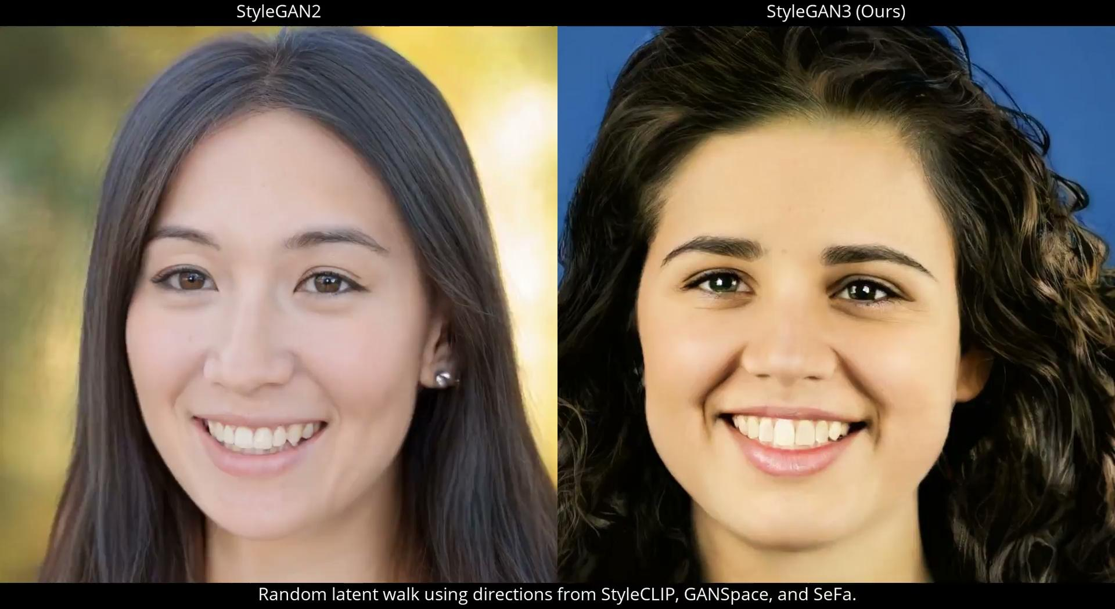
Aside: StyleGAN-3
The current limit of GANs for novel view synthesis
Limited angular range

Slide 17

Aside: StyleGAN-3
The current limit of GANs for novel view synthesis
Very limited angular range
Poor generalization to new image categories. Note the bilateral symmetry artifacts in the landscape generation

Slide 18
Solution: Neural Rendering
Rather than directly output an image, output 3d geometry instead
Image the output of the neural network using a conventional rendering pipeline
Physical parameters learned from observing images and videos
Because the network learns a 3d scene representation, multi-view consistency is guaranteed

Slide 19
Rendering Pipeline

Slide 20
Classical computer graphics
Rendering pipeline consists of 3 stages:

Slide 21
Classical computer graphics
Rendering pipeline consists of 3 stages:
Represent the scene geometry

Slide 22
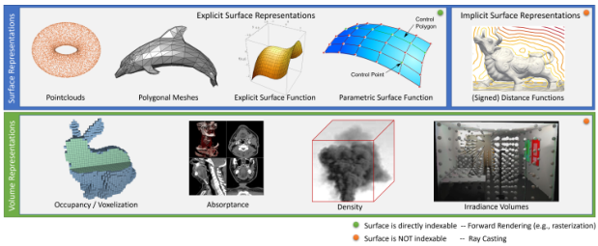
Classical computer graphics
Rendering pipeline consists of 3 stages:
Represent the scene geometry

Slide 23
Classical computer graphics
Rendering pipeline consists of 3 stages:
Represent the scene geometry
We’ll be focusing on volume rendering
Source: Advances in Neural Rendering (Tewari et al 2021)

Slide 24
Classical computer graphics
Rendering pipeline consists of 3 stages:
Represent the scene geometry
Define the camera (AKA image formation model)

Slide 25
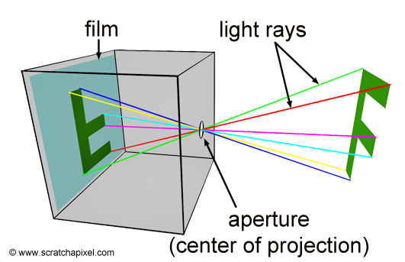
Classical computer graphics
Rendering pipeline consists of 3 stages:
Represent the scene geometry
Define the camera (AKA image formation model)
Source: https://www.scratchapixel.com/lessons/3d-basic-rendering/3d-viewing-pinhole-camera

Slide 26
Classical computer graphics
Rendering pipeline consists of 3 stages:
Represent the scene geometry
Define the camera (AKA image formation model)
Describe the surface appearance

Slide 27
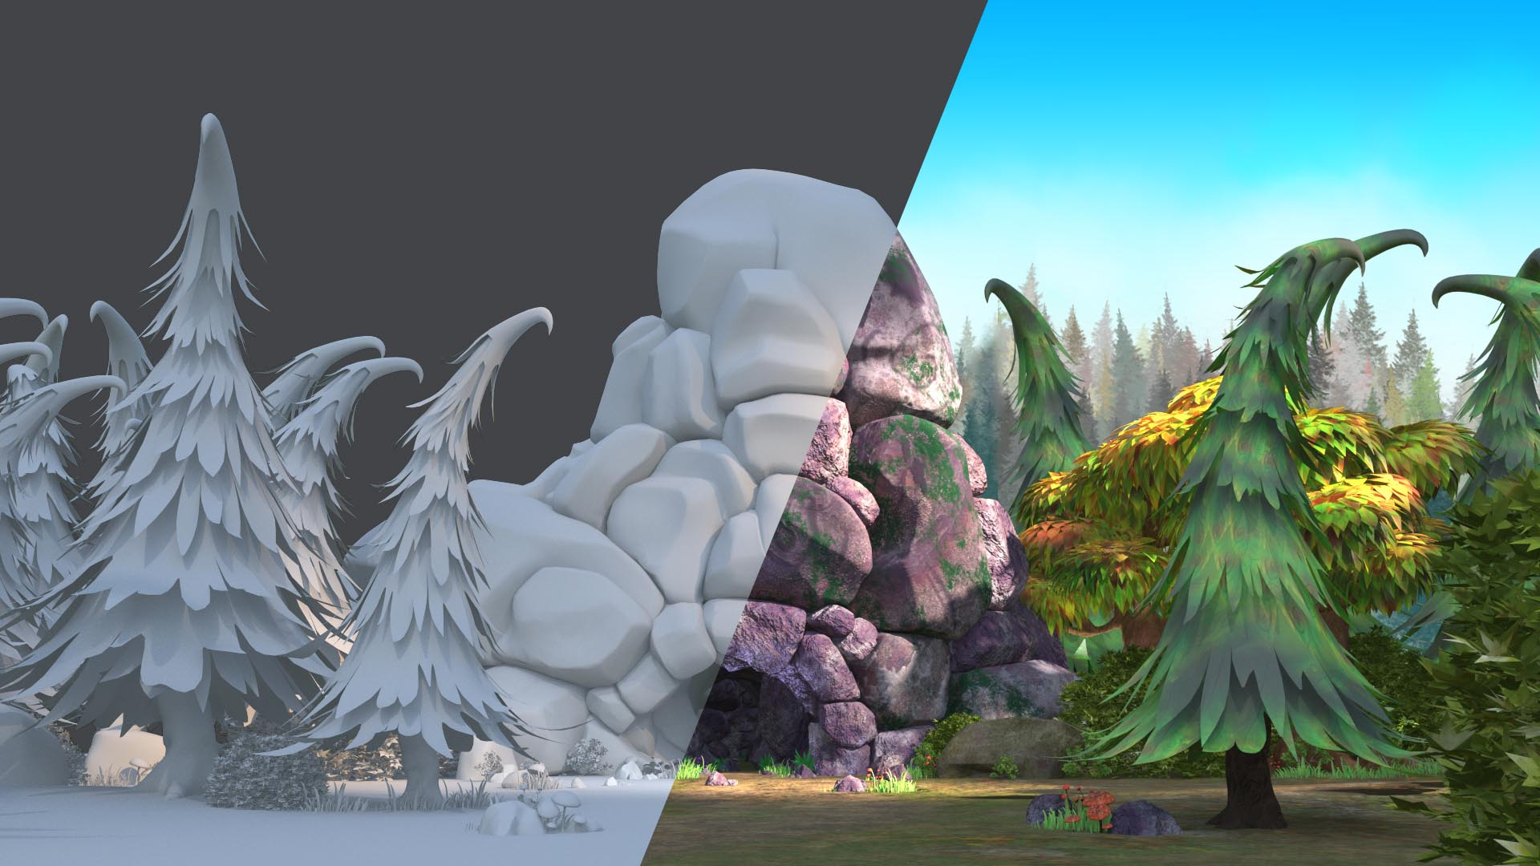
Classical computer graphics
Rendering pipeline consists of 3 stages:
Represent the scene geometry
Define the camera (AKA image formation model)
Describe the surface appearance

Slide 28
Classical computer graphics
Pros:
Allows photorealistic images to be generated
3D representation allows novel viewpoints
Very fast render performance
Geometry shaders allow for precise control of memory footprint

Slide 29
Classical computer graphics
Pros:
Allows photorealistic images to be generated
3D representation allows novel viewpoints
Very fast render performance
Geometry shaders allow for precise control of memory footprint
Cons:
Meshes have to be developed by professional artists
Physical representations are inputs
Estimated via inverse rendering
Requires high quality 3D representations
Lighting model typically trades physical accuracy for performance

Slide 30
Neural Rendering
2014
2015
2016
2017
2018
2019
2020
2021
2022

Slide 31
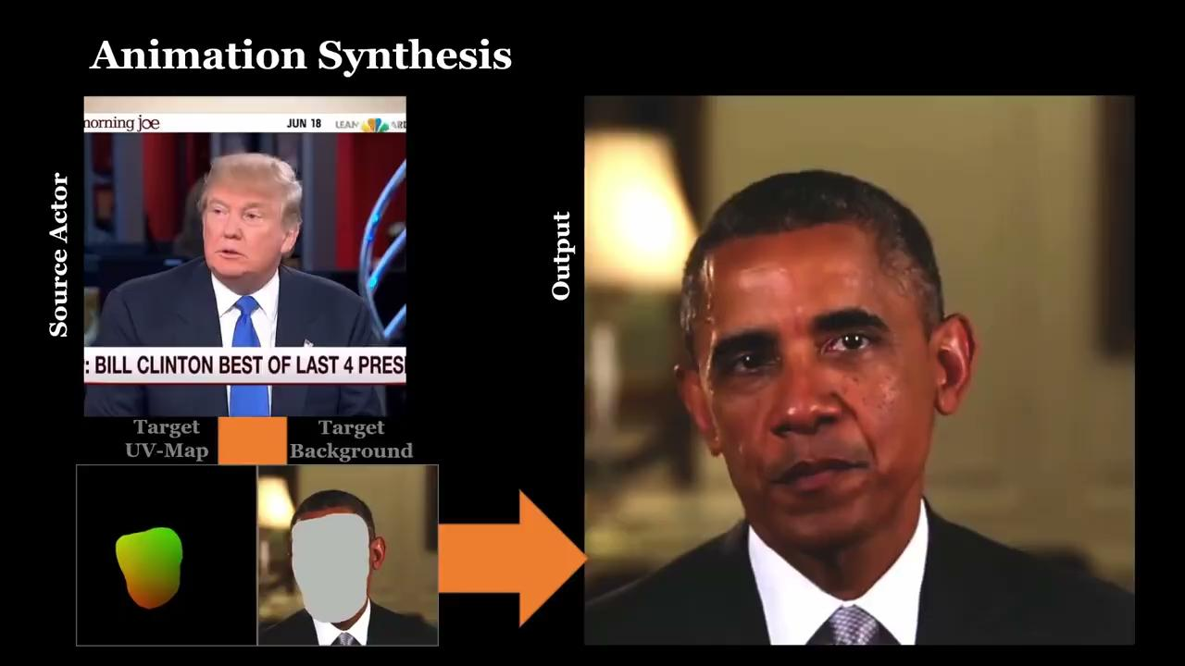
Neural Rendering
Deferred Neural Rendering (Thies, Zollhöfer, Nießner 2019)
2014
2015
2016
2017
2018
2019
2020
2021
2022

Slide 32
Deferred neural rendering (2019)
Solution to imperfect 3D input such as videos

Slide 33
Deferred neural rendering (2019)
Solution to imperfect 3D input such as videos
Combines traditional pipeline with neural textures

Slide 34
Deferred neural rendering (2019)
Solution to imperfect 3D input such as videos
Combines traditional pipeline with neural textures
Neural textures:
Optimized following screen capture
Set of high dimensional optimal features mapped on 3D meshes

Slide 35
Deferred neural rendering (2019)
Solution to imperfect 3D input such as videos
Combines traditional pipeline with neural textures
Neural textures:
Learned during the scene capture
Set of high dimensional optimal features mapped on 3D meshes
Allows editable 3D scenes

Slide 36
Neural Radiance Fields (NeRF)

Slide 37
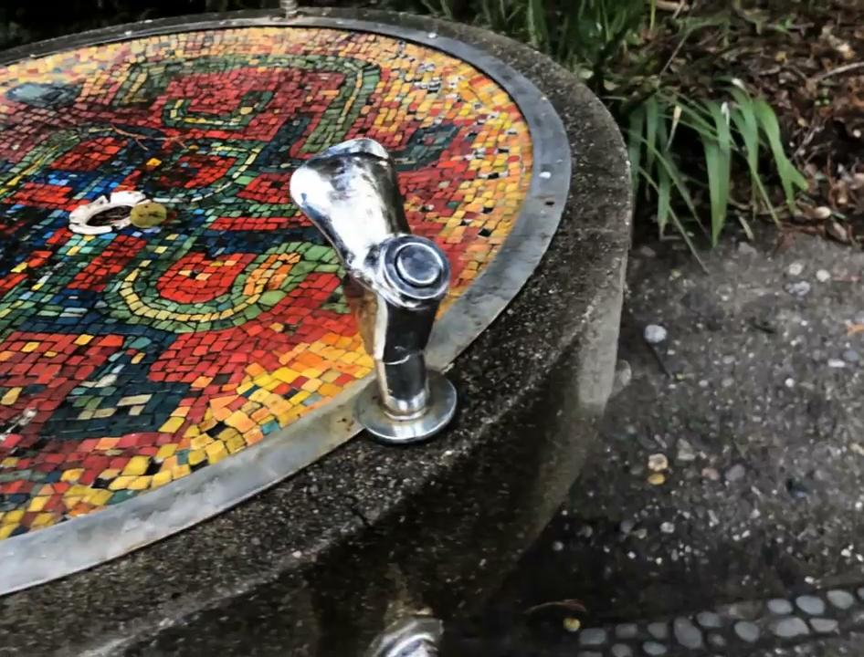
Solution: Neural Rendering
2014
2015
2016
2017
2018
2019
2020
2021
2022
Neural Radiance Fields (Mildenhall et al 2020)

Slide 38
Overview of NeRF
Novel view synthesis
Use neural net to represent scene as continuous function
Synthesize views given coordinates and viewing angle
Achieve SOTA rendering qualities at the time

Slide 39
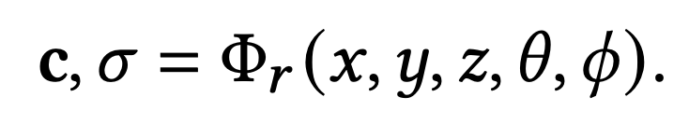
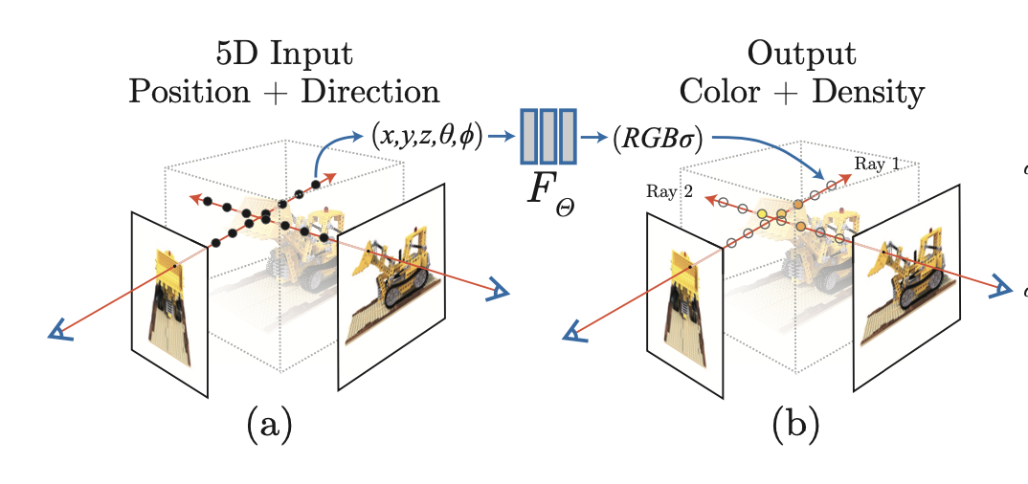
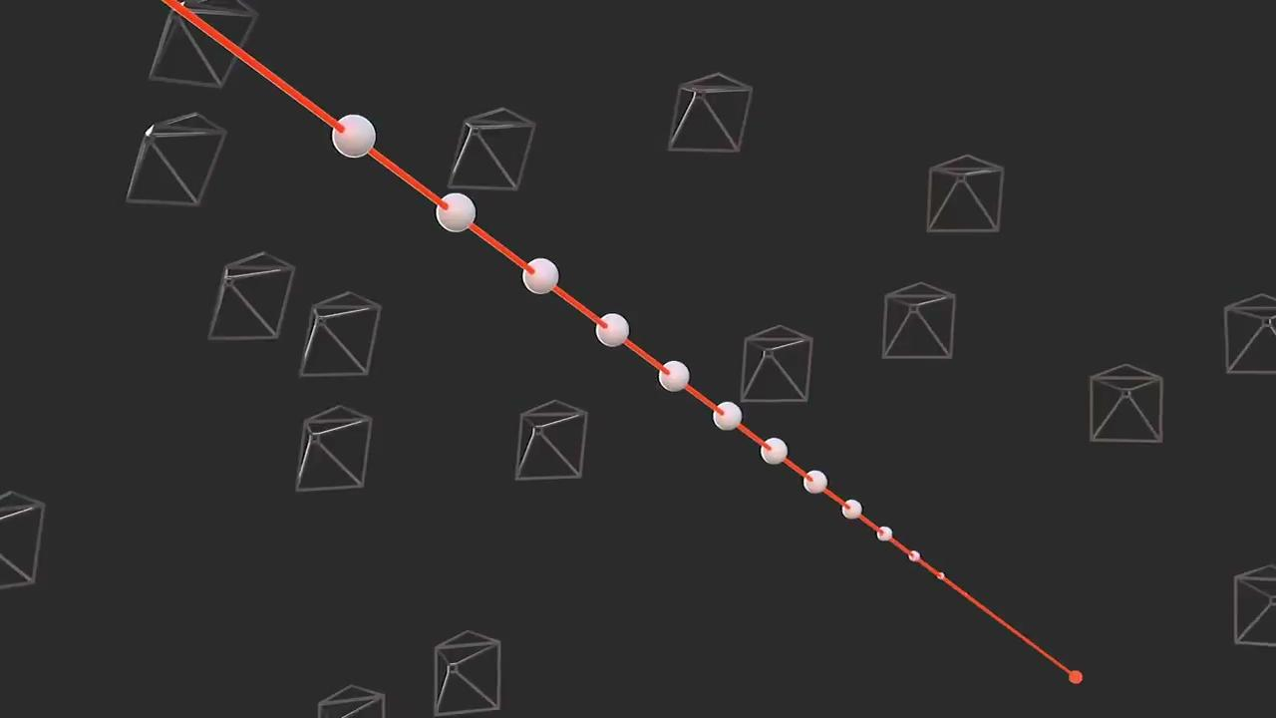
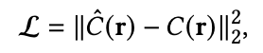
Method
Map coordinate and view to color and density
Utilize Fourier features to improve bandwidth
Optimized to minimize MSE on predicted and actual color on sampled rays

Slide 40
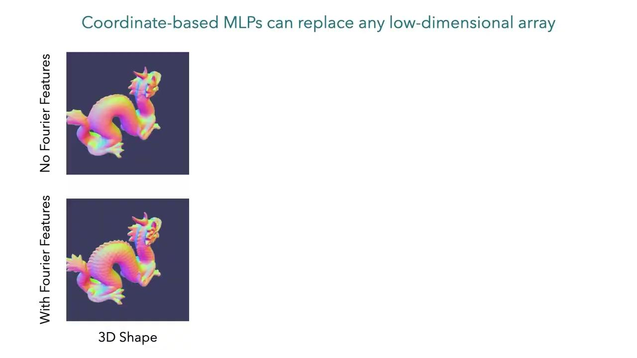

Slide 41
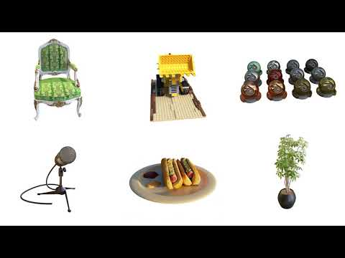
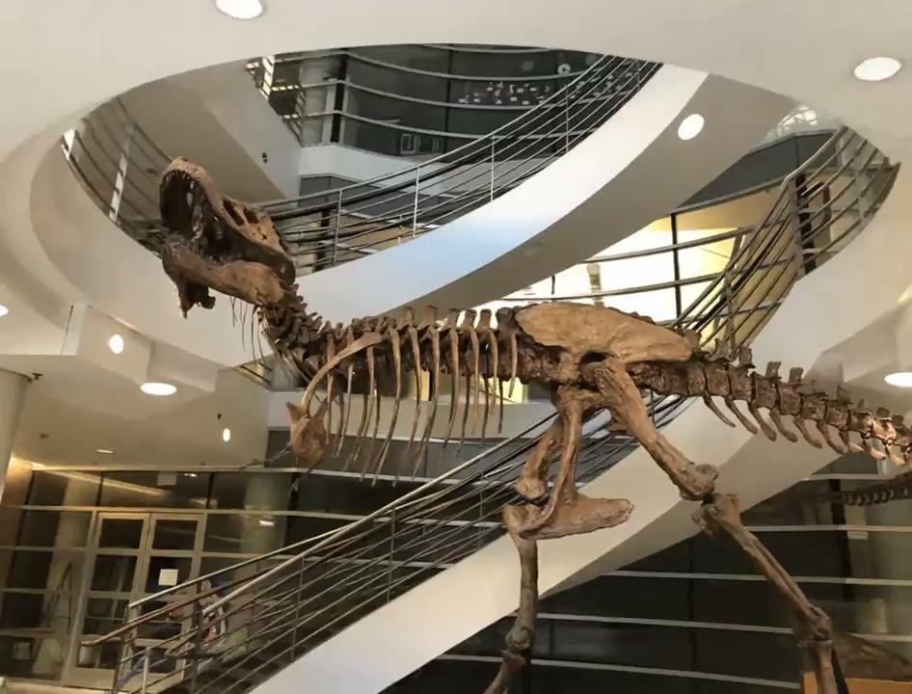
NeRF Renderings

Slide 42
Improving performance
The original NeRF paper proposes a coarse-to-fine sampling strategy
This requires a large number of samples (~200) per pixel
Most samples are of empty space
Possible approaches to improving performance:
Spatial data structures
Depth supervision
Alternative network architectures
Non neural network methods

Slide 43
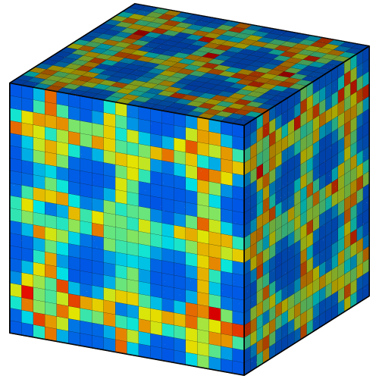
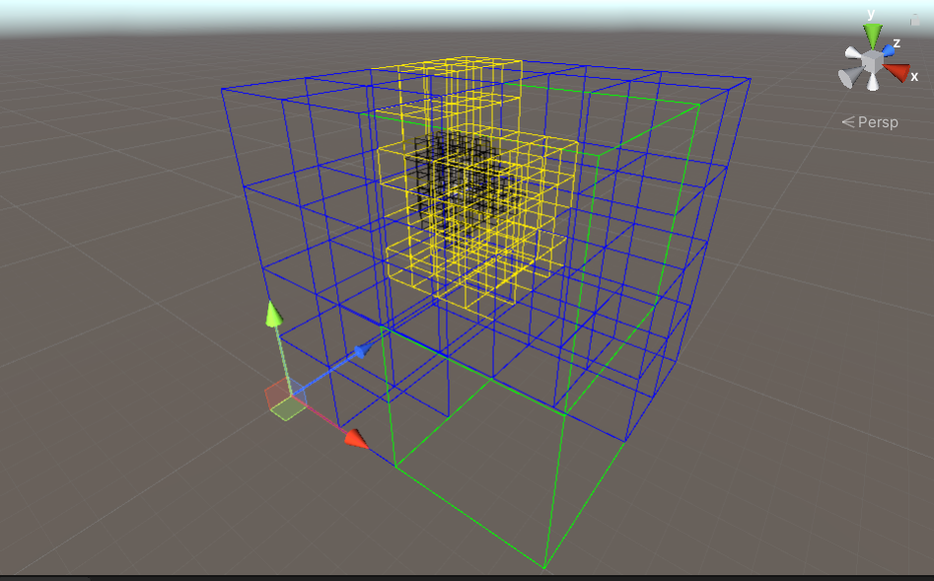
Spatial data structures
A typical idea is to partition space into axis-aligned bounding boxes (AABB) to accelerate ray-object intersection testing
Ideally, data structure should be hierarchical so memory footprint can be controlled
Some typical data structures used in volume rendering:
Voxel grid (not hierarchical!)
Voxel octree
https://www.ovito.org/docs/current/reference/pipelines/visual_elements/voxel_grid.html
https://github.com/patrikholler/Unity-Simple-Octree

Slide 44
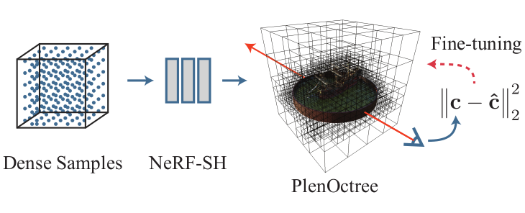
Spatial data structures
2014
2015
2016
2017
2018
2019
2020
2021
2022

Slide 45
Spatial data structures
PlenOctrees (Yu et al 2021)
2014
2015
2016
2017
2018
2019
2020
2021
2022

Slide 46
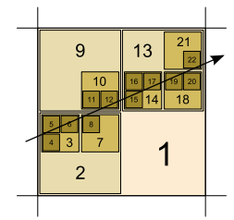
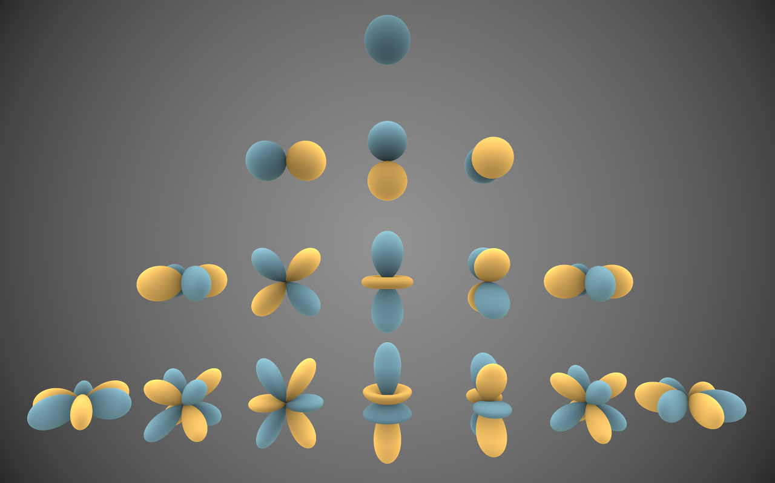
PlenOctrees
Developed by Yu et al (2021)
A spatial data structure approach
Jointly optimize a sparse voxel octree along with spherical harmonic (SH) coefficients on grid lattice points
By outputting SH coefficients instead of RGB values, rendering requires only one evaluation of the network per query ray. With hardware acceleration, rendering speeds >150 fps can be achieved.
As an added benefit, relighting of the scene can be done at no additional cost
Efficient Sparse Voxel Octrees (Laine, Karras 2010)
https://en.wikipedia.org/wiki/Spherical_harmonics

Slide 47
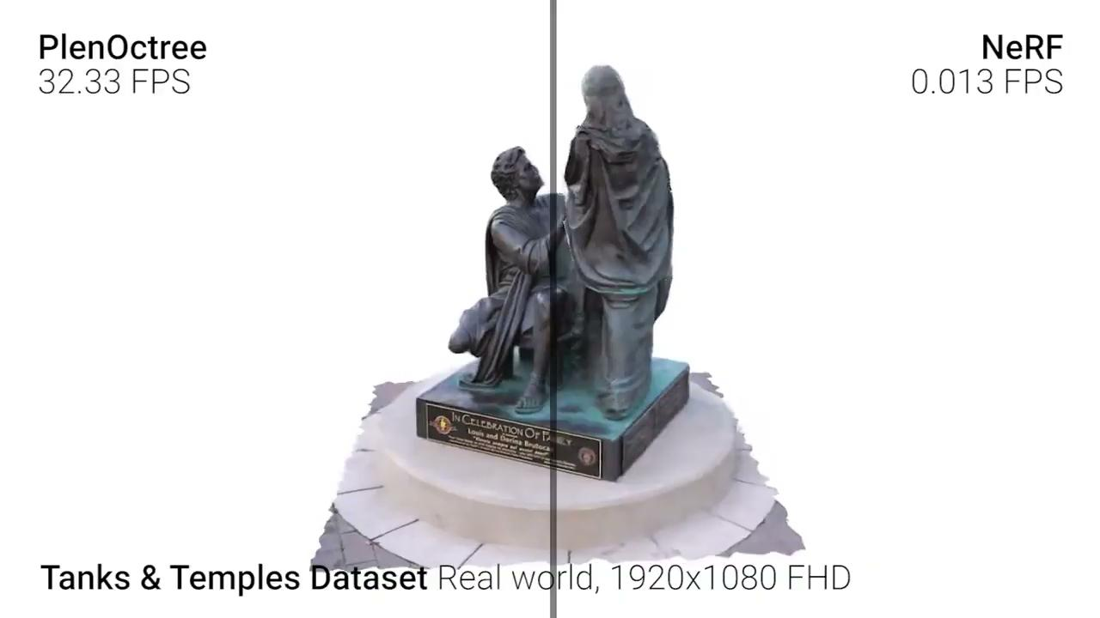

Slide 48
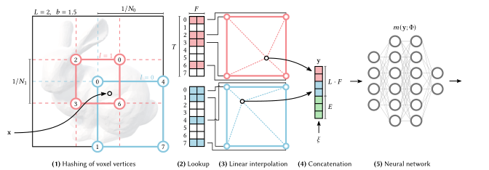
Instant Neural Graphics Primitives
Another spatial data structure approach
Uses multiple resolutions of 3d volume grids
Each lattice point of each volume grid is hashed to a learned feature vector
Query points (x, y, z) are evaluated by linearly interpolating the feature vectors their containing volume element’s corners
Interpolated feature vectors are concatenated, then passed through a compact fully connected network

Slide 49
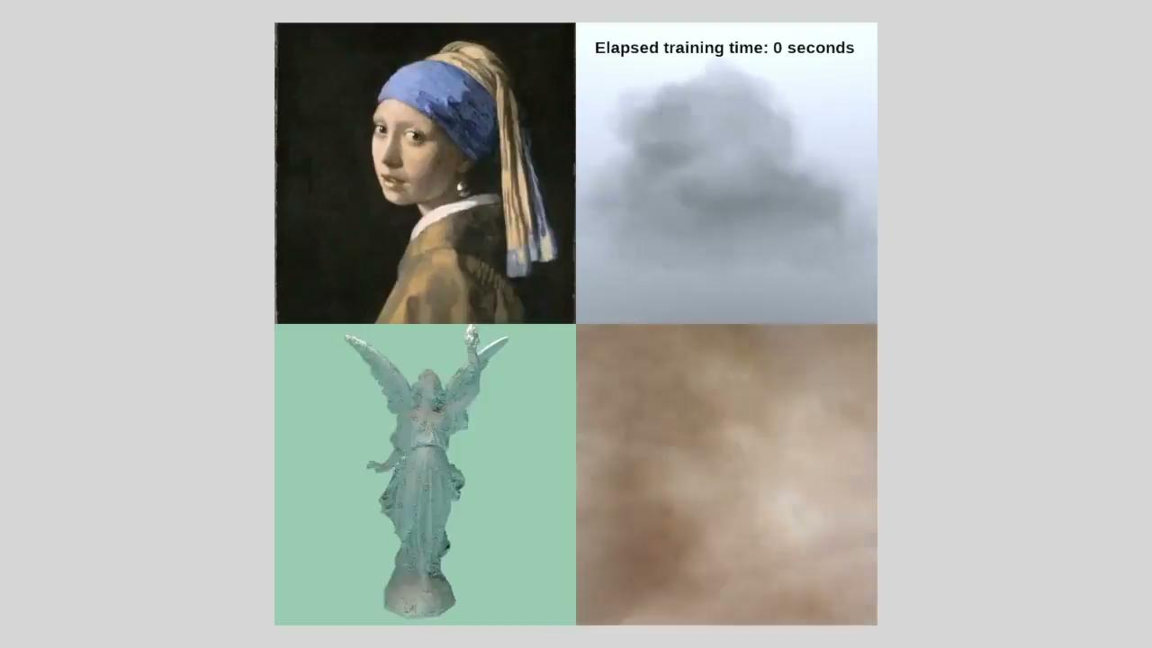
Instant Neural Graphics Primitives

Slide 50
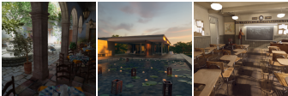
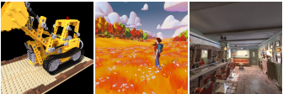
Depth supervision
DONeRF (Neff et al 2021) uses depth mapping to improve sampling selection
DONeRF trains a small “oracle network” using ground truth depth maps
For each segment on each ray, the oracle network classifies the segment as either good (1) or bad (0) to sample from
Also employs a novel coordinate transformation which allows for rendering of unbounded scenes

Slide 51
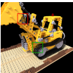
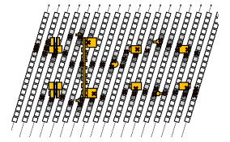
Depth supervision
Visualization of DONeRF sampling strategy
Yellow boxes are slices of the bulldozer
White squares are classified as 0 by the oracle network (bad sample locations)
Black squares are classified as 1 by the oracle network (good sample locations)
X’s show the sample locations along each ray that are fed as input into the NeRF

Slide 52
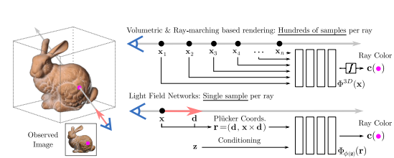
Light Field Networks
Sitzmann et al 2021
Deviates from the volumetric rendering framework
Query rays are input to the network, which directly outputs a predicted radiance
This allows for a x100 speedup of optimization time
Render time is also improved to real time speed
Main drawback: sacrifices multi-view consistency
Currently only used for low detail scenes

Slide 53
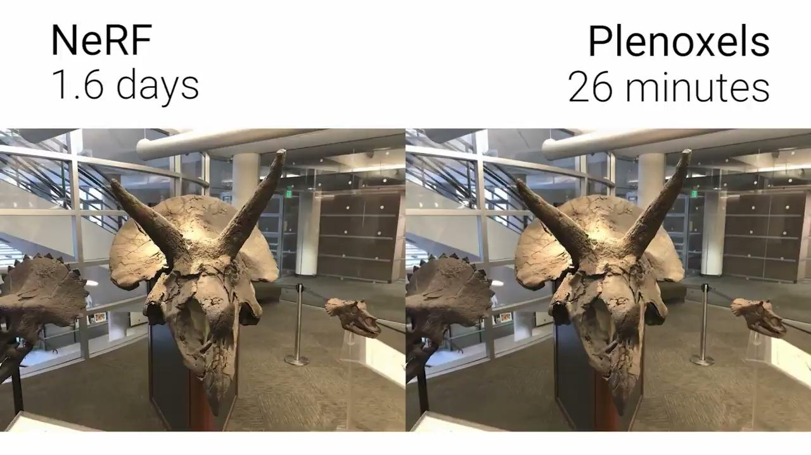
Plenoxels: Radiance fields without neural networks
Similar approach to PlenOctrees; also developed by Yu et al (2021)
Use trilinear interpolation to get a continuous representation of a volume
Directly use gradient descent to optimize SH coefficients with respect to rendered pixel values
Moving away from neural networks gives x100 increase in optimization speed, and allows for interactive rendering (15 fps)

Slide 54
Dynamic NeRF

Slide 55
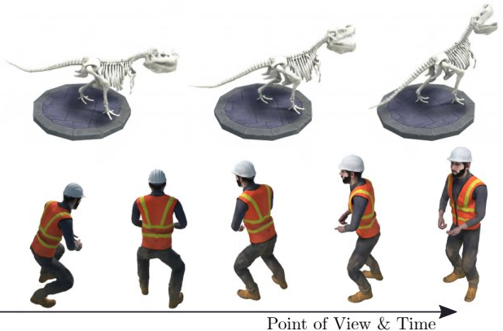
Dynamic NeRF
2014
2015
2016
2017
2018
2019
2020
2021
2022
D-NeRF: Neural Radiance Fields for Dynamic Scenes (Pumarola et al 2020)

Slide 56
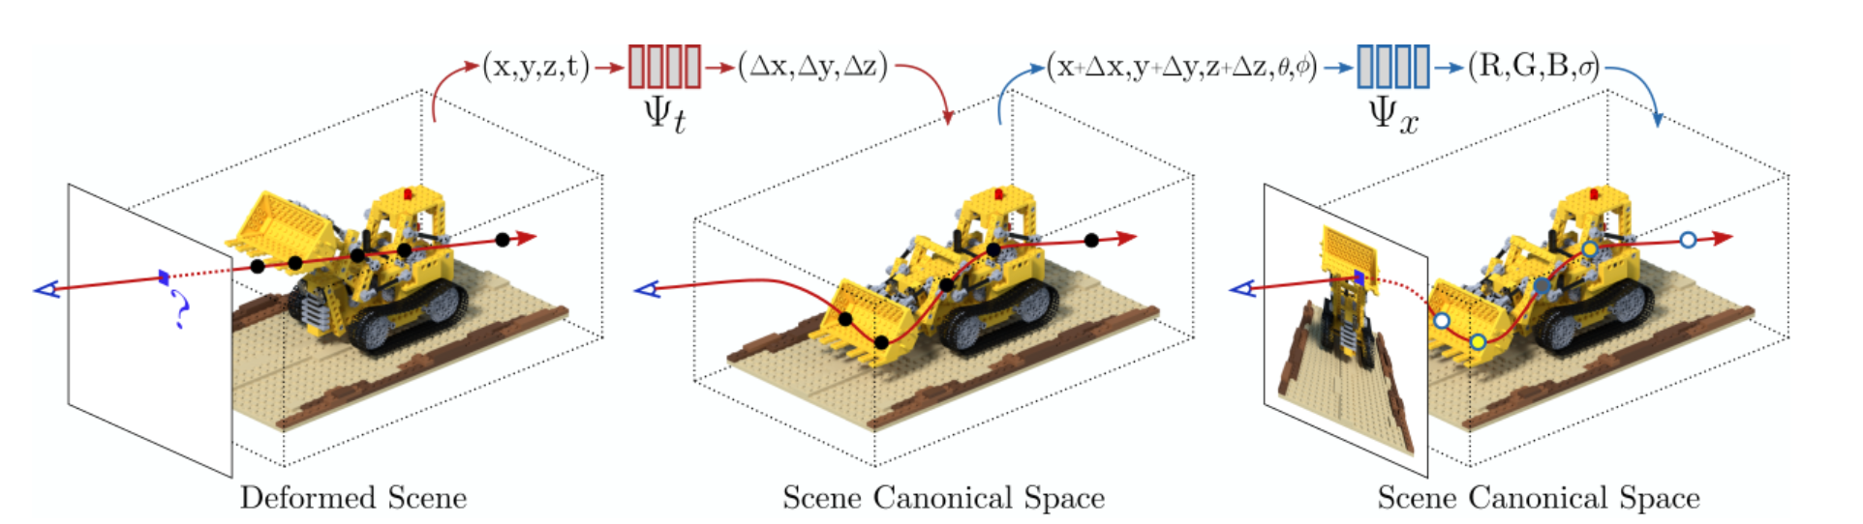
Application of NeRF to Dynamic Scenes
Objective: Given a set of images of a scene captured at different points in time, render new viewpoint at specified time
Key challenge is in encoding temporal information
Pumarola et al (2020) divide this task into two…
Represent the scene given coordinate + time
Map the representation to the deformed view given the view angle

Slide 57
Training Dynamic NeRF
End-to-end training (canonical network & deformation network are trained together)
Randomly sample pixels corresponding to rays from various angles
Trained to minimize the MSE given the sampled training images

Slide 58
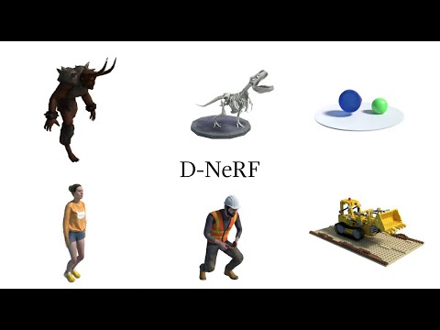
Synthesized Dynamic Scenes Using D-NeRF

Slide 59
Improvements on D-NeRF
No 3D priors
Quality Improvements
Still have high training cost

Slide 60
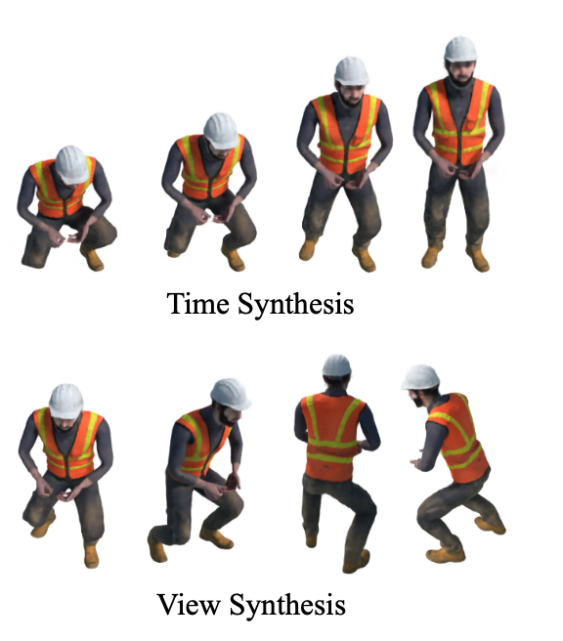
Fast Dynamic NeRF Using Neural Voxels Overview
Improvement on D-NeRF
Primarily improves quality (but also speed) of renderings
Uses explicit representation of 3D scene
Challenges
Capturing temporal information
Representing different motion scales

Slide 61
Voxel Features
NeRF uses implicit representation of scene
High storage efficiency
Low training and inference speed
Neural voxels
Explicit representation
Improved convergence

Slide 62
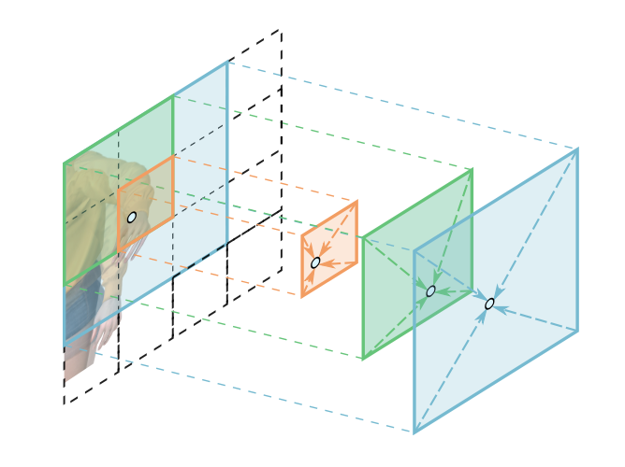
Spatial and Temporal Encoding
Neural model infers feature from neighboring voxels
Sample voxel input features at different strides
Aims to capture motion at different scales
Positional encoding
Temporal encoding

Slide 63
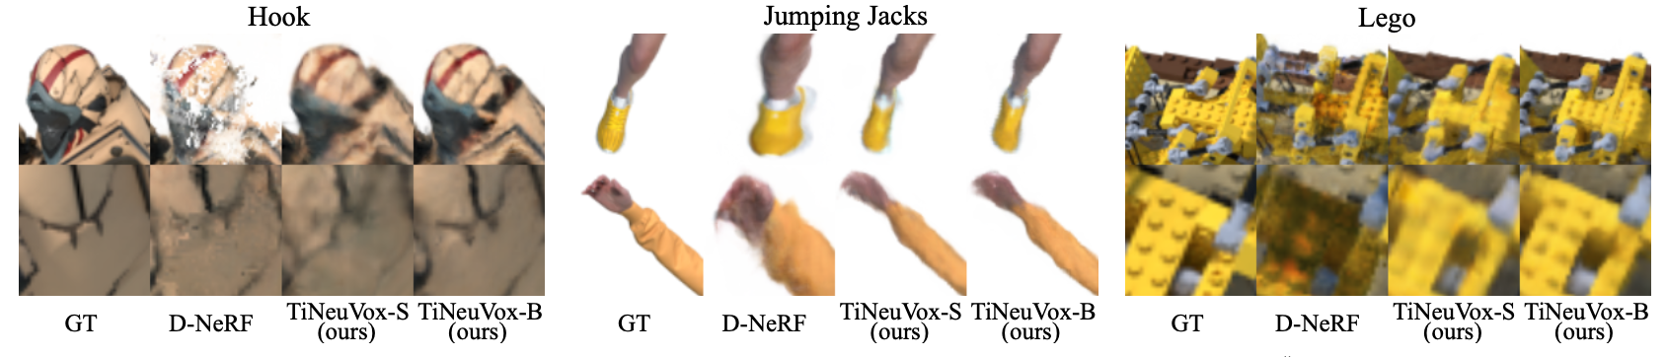
Experiments
Directly minimizes MSE (same as all)
3D priors and feature encoding helps reduce training to <30 min
Achieves major qualitative improvement over D-NeRF

Slide 64
Future Work

Slide 65
Future Work
NeRFs depend on posed cameras. Input viewpoint optimization is a hard problem.
All NeRF models suffer from reconstruction artifacts
Spatial data structures force a tradeoff between memory and performance. Is good render performance possible without greatly increasing memory overhead?

Slide 66
Thank You!

